Slide 1
Introduction to ML.NET
Presented by
MD. Amjad Hossain
Software Engineer
Secure Link Services BD Ltd
SELISE | Amjad

Slide 2
What is Machine Learning

Slide 3
What is Machine Learning
Programming the unprogrammable

Slide 4
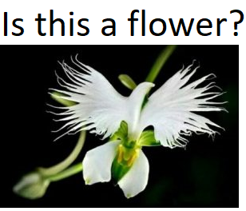
What is Machine Learning
Programming the unprogrammable
f(x) {

Slide 5
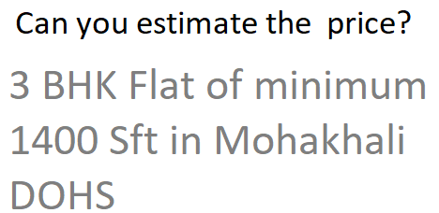
What is Machine Learning
Programming the unprogrammable
f(x) { f(x) {

Slide 6
What is Machine Learning
Programming the unprogrammable
f(x) { f(x) {
Model Model

Slide 7
What is Machine Learning
Programming the unprogrammable
f(x) { f(x) {
Model Model
Machine Learning creates this function using data

Slide 8
Model building flows
Raw data
Pre-process
Feature extraction
Deploy Model
Apply ML Algorithm
Validate Model
Test Model

Slide 9
Model building flows
Raw data
Pre-process
Feature extraction
Deploy Model
Apply ML Algorithm
Validate Model
Test Model

Slide 10
Model building flows
Raw data
Pre-process
Feature extraction
Deploy Model
Apply ML Algorithm
Validate Model
Test Model

Slide 11
Model building flows
Raw data
Pre-process
Feature extraction
Deploy Model
Apply ML Algorithm
Validate Model
Test Model

Slide 12
Model building flows
Raw data
Pre-process
Feature extraction
Deploy Model
Apply ML Algorithm
Validate Model
Test Model

Slide 13
Model building flows
Raw data
Pre-process
Feature extraction
Deploy Model
Apply ML Algorithm
Validate Model
Test Model

Slide 14
Model building flows
Raw data
Pre-process
Feature extraction
Deploy Model
Apply ML Algorithm
Validate Model
Test Model

Slide 15
ML.NET
Machine Learning framework to build ML Models
Reuse .NET Skill (C# or F#)
Trusted & Proven at scale (PowerBI, Outlook, Bing)
Easy ML model builder (Model builder and CLI)
Extensible (TensorFlow, ONNX, Infer.NET and more are coming)
Free, Cross-platform and Open source

Slide 16
Thank you

